Slide 1
EA Sports FIFA 18 Predicting a Footballer’s Ball Control Rating
Jeff Nguyen
Ernesto Frausto

Slide 2
Dataset
N = 17995
159 Categories
Derived from EA Sports FIFA 18 video game Player Characteristics.
https://www.kaggle.com/kevinmh/fifa-18-more-complete-player-dataset/version/5

Slide 3
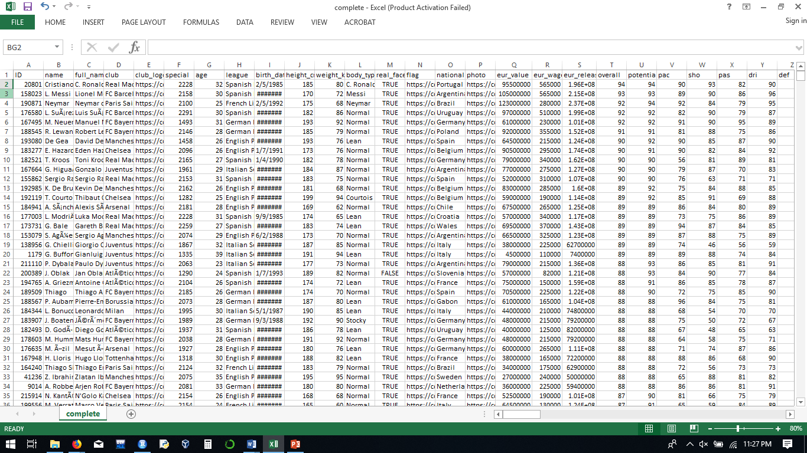
Dataset

Slide 4
Variable Types
Response – Ball Control (Numeric)
Explanatory:
Foot preference (Categorical- Left footed, Right Footed)
Acceleration (Numeric)
Reactions (Numeric)
Jumping (Numeric)
Strength (Numeric)
Shot power (Numeric)
Interceptions (Numeric)
International reputation (Numeric)

Slide 5
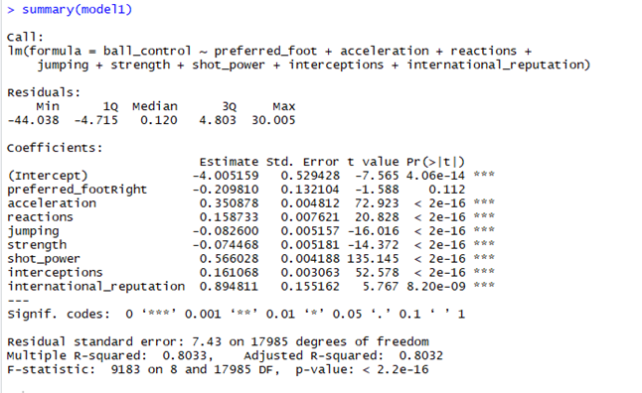
Proposed Linear Model

Slide 6
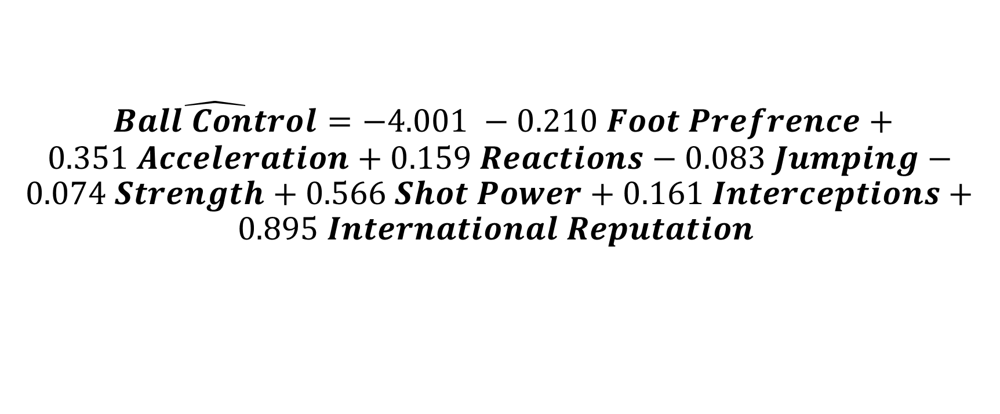
Proposed Linear Model
$\hat{Ball Control}=−4.001 −0.210 Foot Prefrence+0.351 Acceleration+0.159 Reactions−0.083 Jumping−0.074 Strength+0.566 Shot Power+0.161 Interceptions+0.895 International Reputation$

Slide 7
Explanatory Correlations
> cor(data[,c(44,47,49,50,52,55,28)]) acceleration reactions shot_power jumping strength interceptions international_reputation acceleration 1.00000000 0.1906869 0.5374073 0.2138471 -0.1624159 0.1515498 0.05620872 reactions 0.19068688 1.0000000 0.4052669 0.2540297 0.2864192 0.3284484 0.45733581 shot_power 0.53740725 0.4052669 1.0000000 0.1713036 0.1653654 0.2661381 0.22548416 jumping 0.21384706 0.2540297 0.1713036 1.0000000 0.2681503 0.2911186 0.13302383 strength -0.16241591 0.2864192 0.1653654 0.2681503 1.0000000 0.3558542 0.14859151 interceptions 0.15154983 0.3284484 0.2661381 0.2911186 0.3558542 1.0000000 0.13460985 international_reputation 0.05620872 0.4573358 0.2254842 0.1330238 0.1485915 0.1346098 1.00000000 Max R Value: 0.53740725 Shot Power and Acceleration Min R Value: -0.16241591 Strength and Acceleration
>

Slide 8
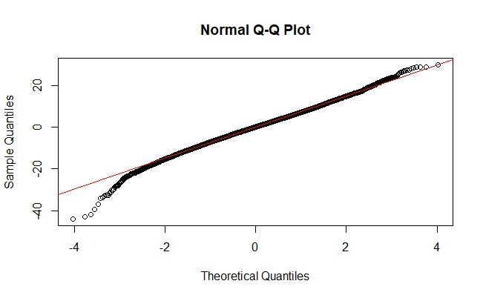
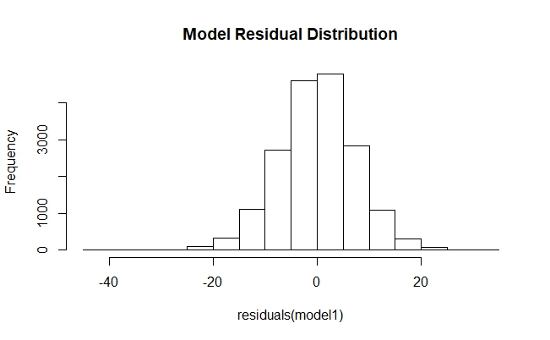
Residual Normality Check

Slide 9
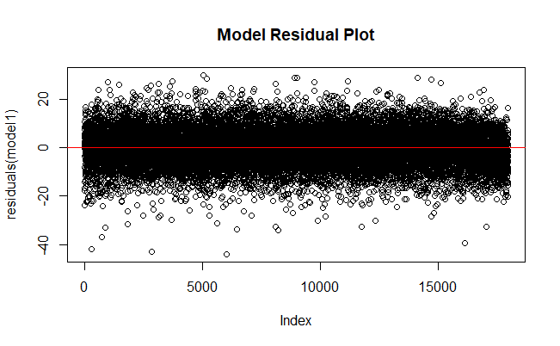
Model Residual Plot

Slide 10
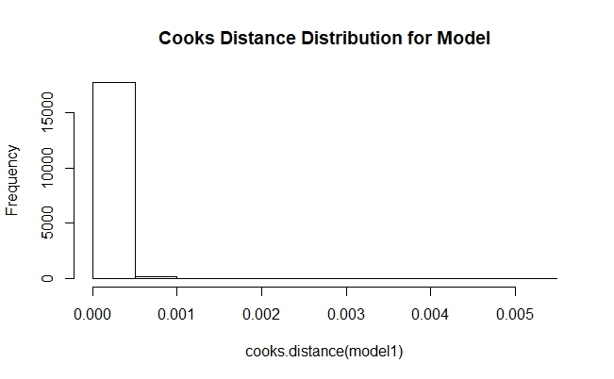
Outlier Check

Slide 11
Final Model

